Slide 1
CONTENT
AFFINE TRANSFORM
POINTER
FUNCTION
OOPs
VS CODE LEARNING

Slide 2
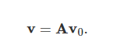
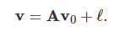
AFFINE TRANSFORM
Affine transformations are a class of mathematical operations that encompass rotation, scaling, translation, shearing, and several similar transformations that are regularly used for various applications in mathematics and computer graphics. To start, we will draw a distinct (yet thin) line between affine and linear transformations before discussing the augmented matrix formalism typically used in practice
If we treat this point as a 1×2 vector, we can transform it into another 1×2 vector by multiplying it with a 2×2 transformation matrix. These types of operations are known as linear transformations and are often notated as,
Affine transformations extend linear transformations beyond this limitation and allow us to also translate our initial vector locations such that
Here, ℓ is an n×1 translation vector. To understand the power of these transformations, it is important to see them in practice.

Slide 3
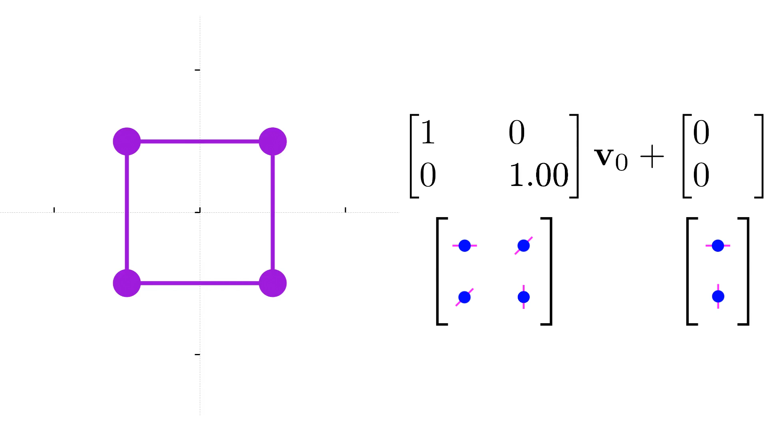
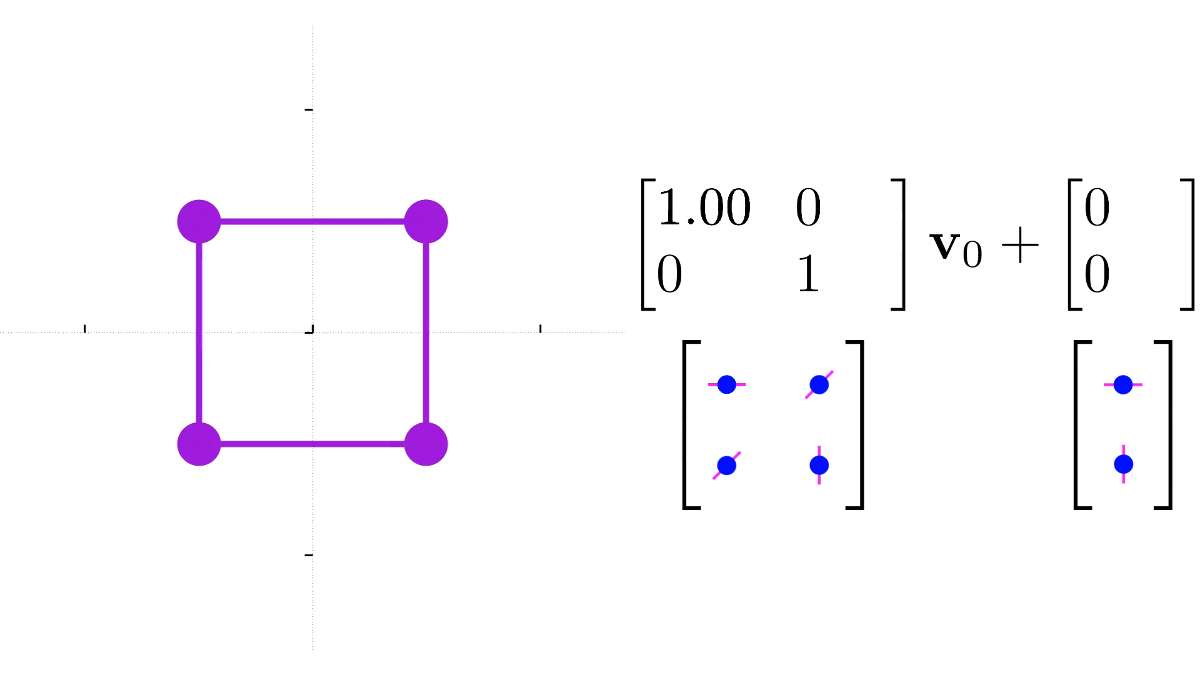
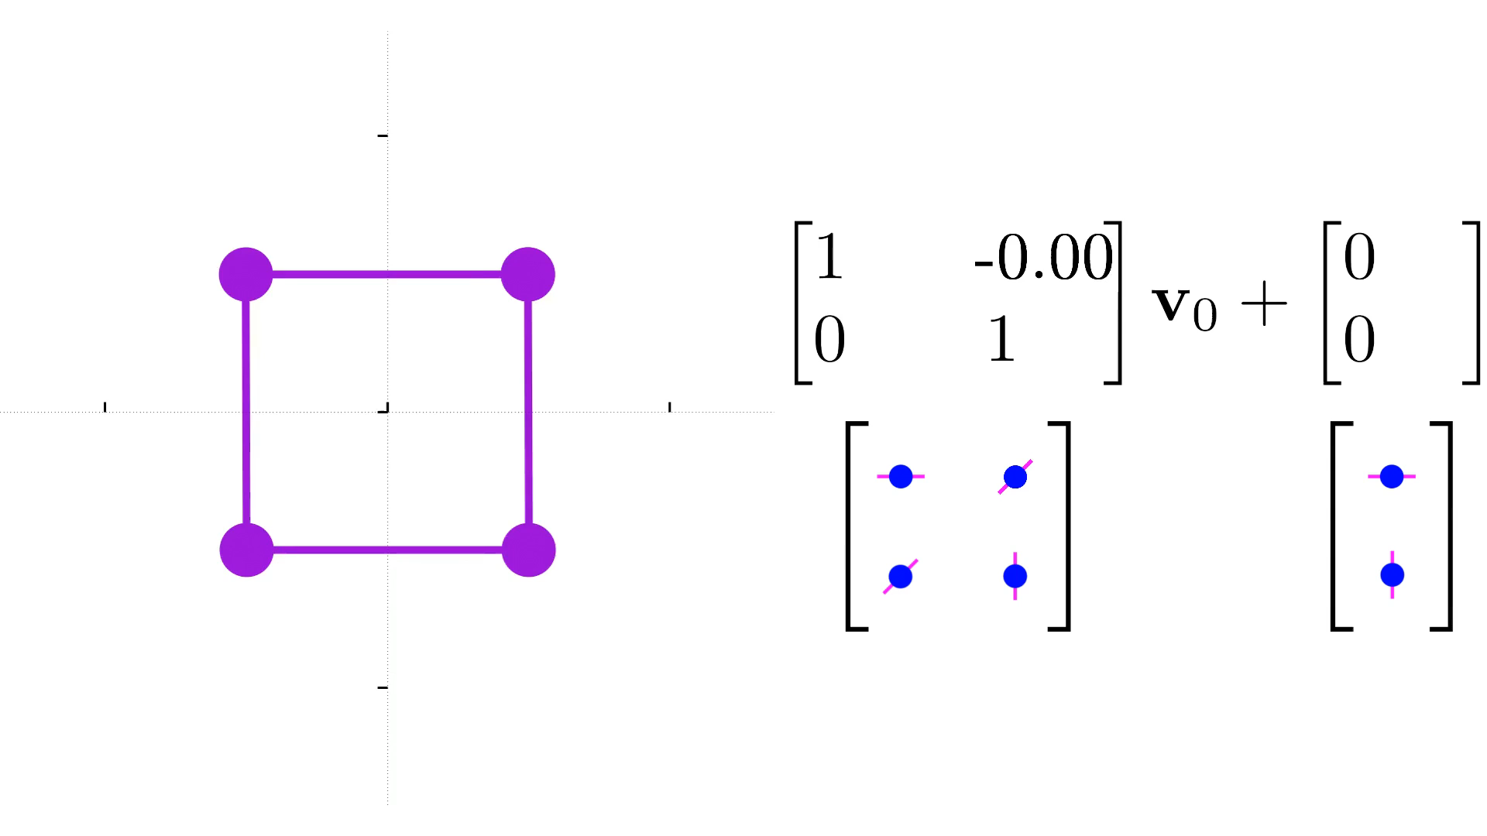
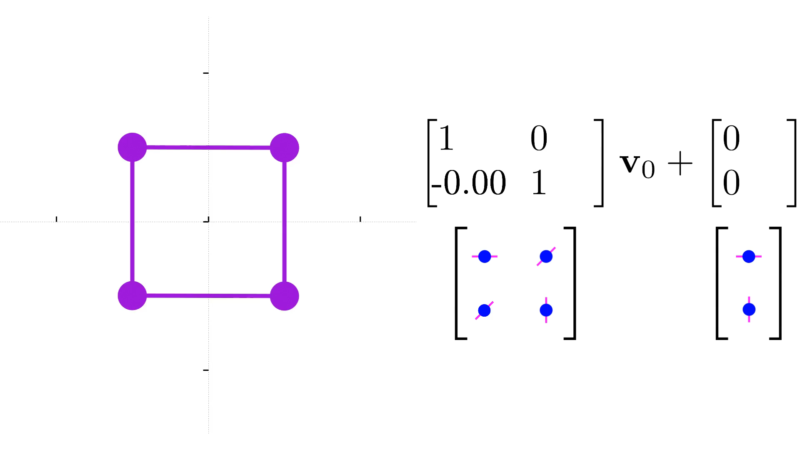
Scaling along x
Scaling along Y
Shearing along x
Shearing along y

Slide 4
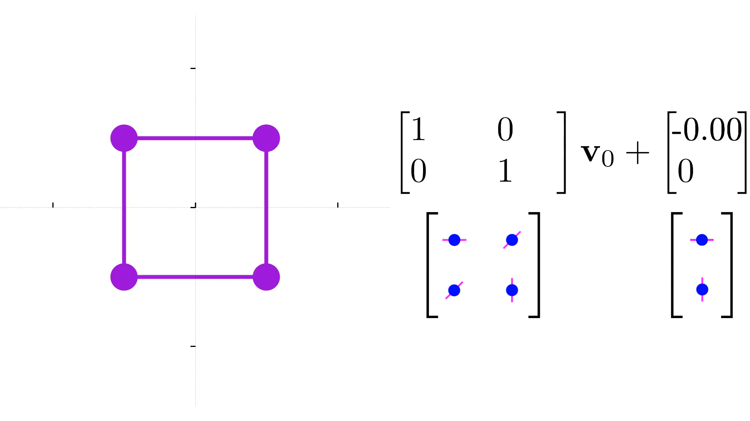
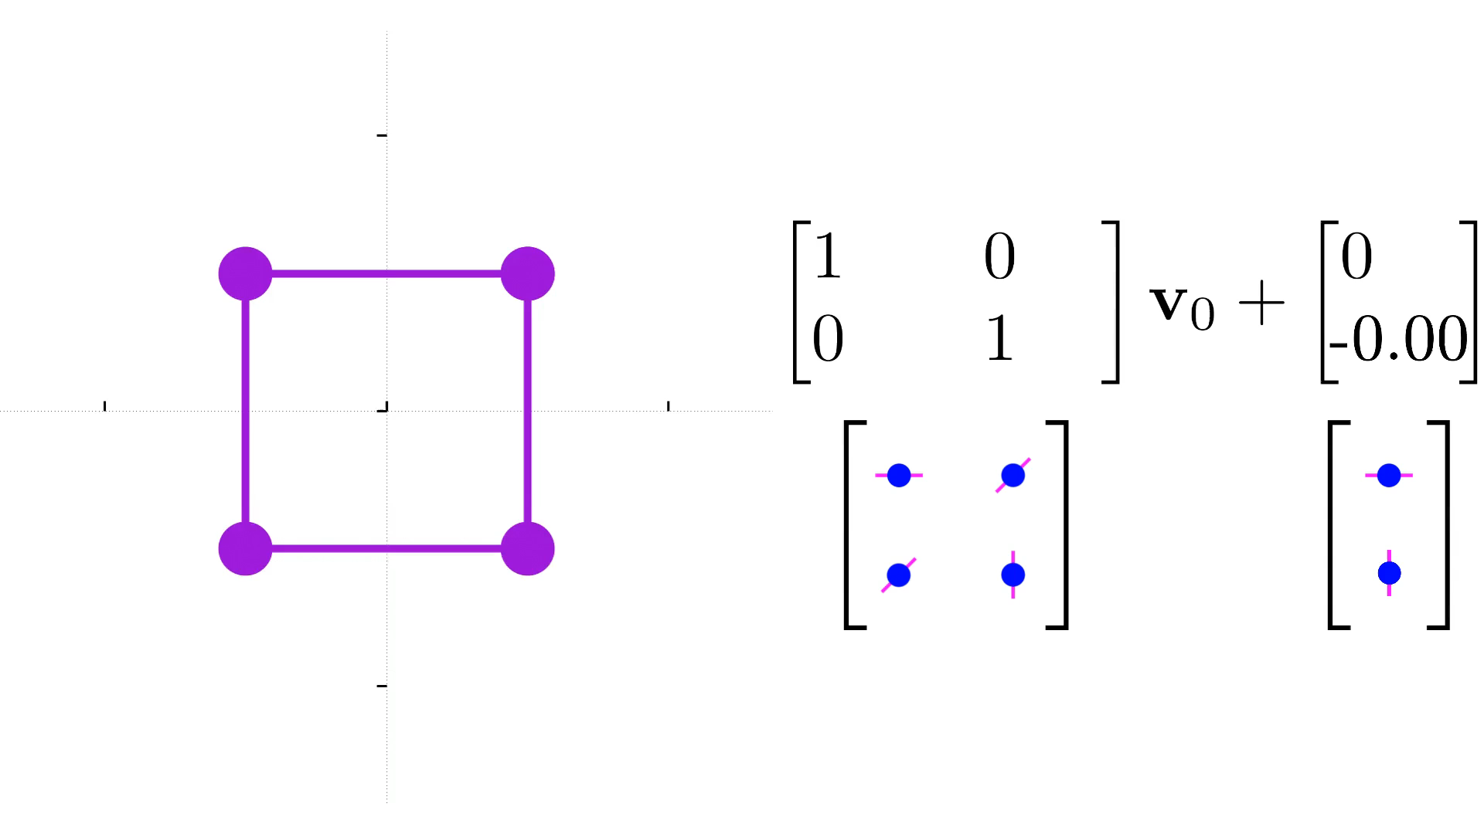
Translation along x
Translation along y

Slide 5
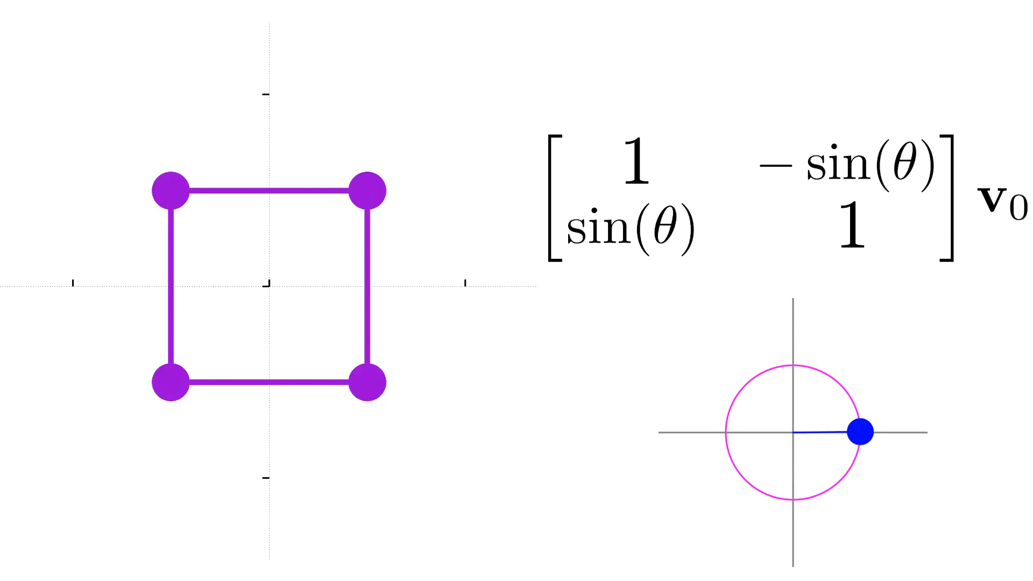
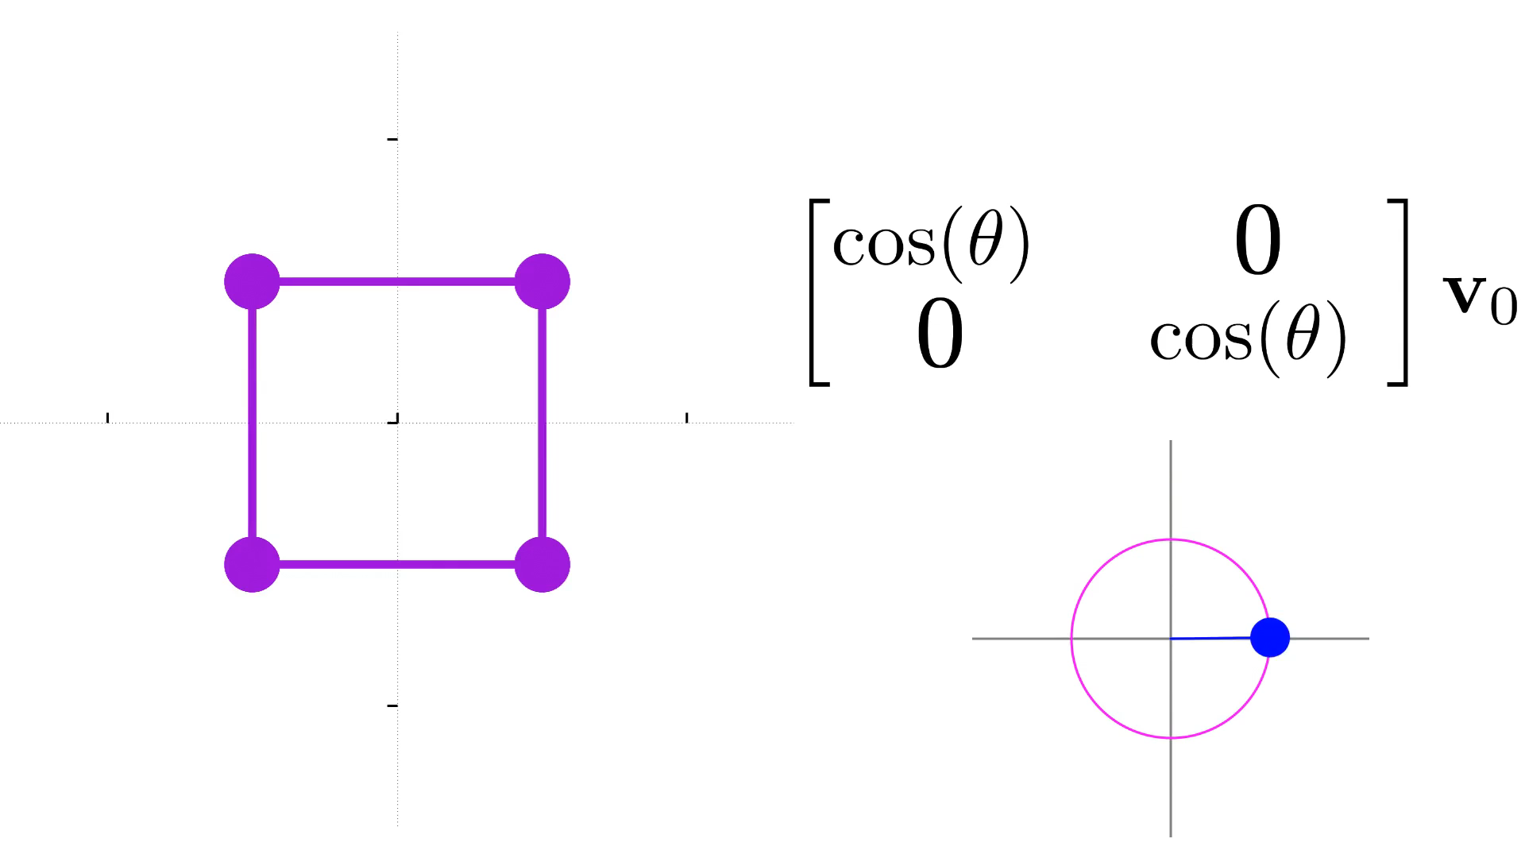
Rotation
Just sines
Just cosines
Here, we see two completely different behaviors:

Slide 6
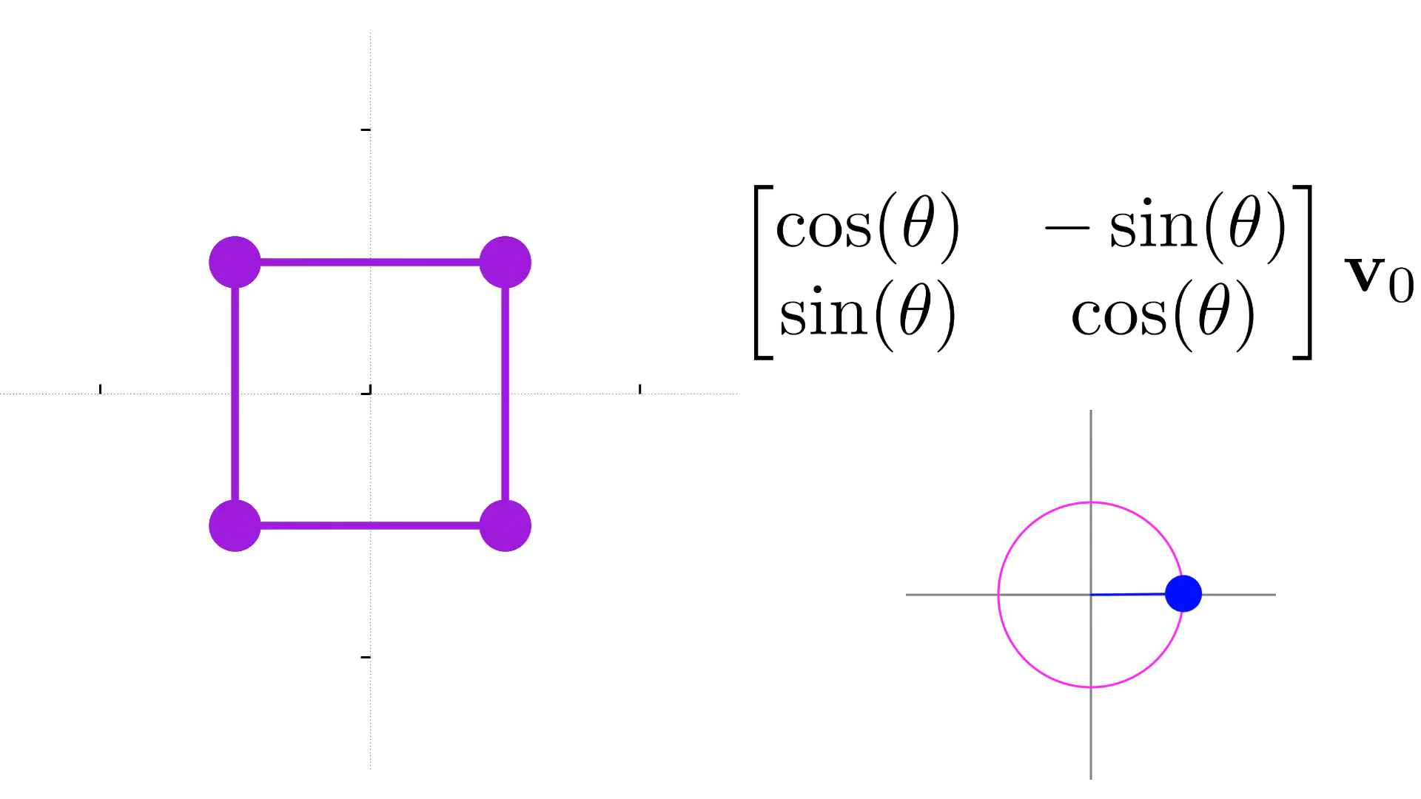
How these two different interactions will work together in practice

Slide 7
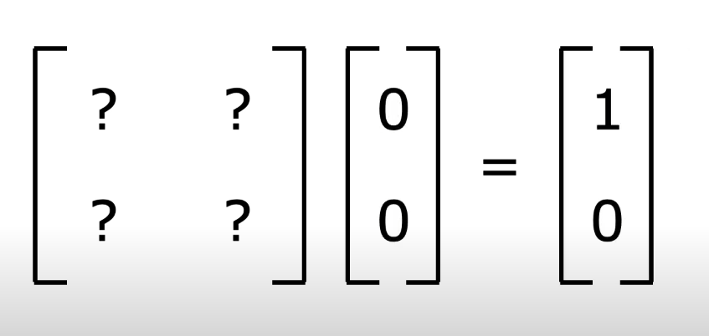
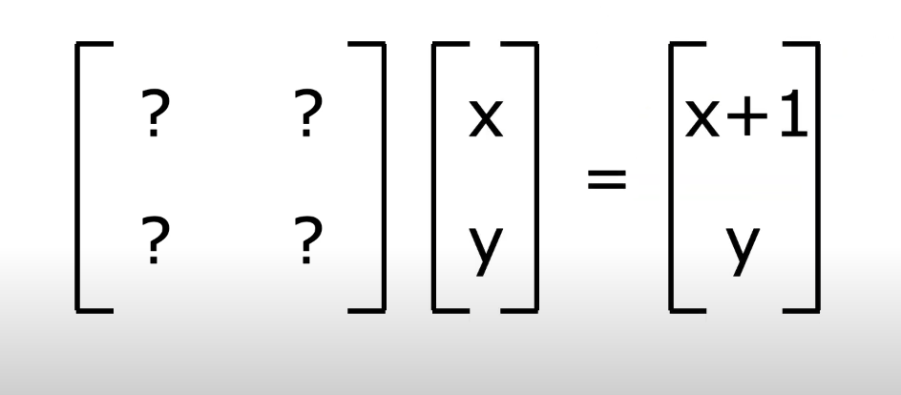
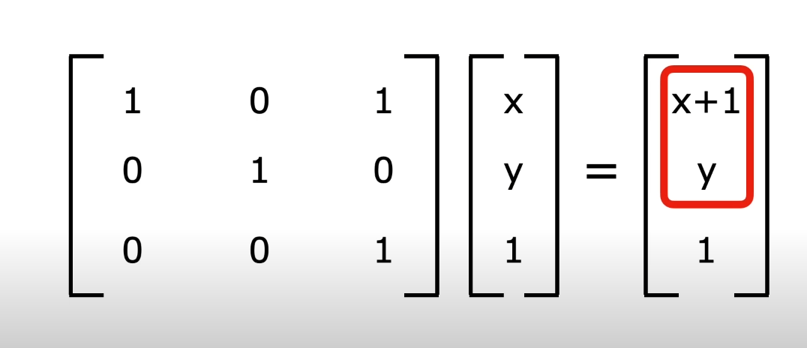
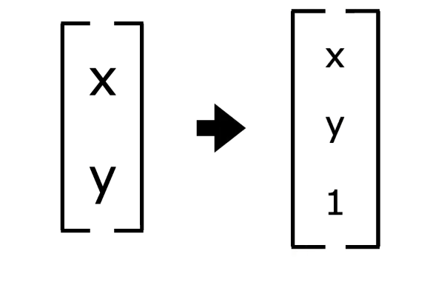

Translation
Translation is not a linear transformation.
Linear Transformation - We don’t change the origin ( center)

Slide 8
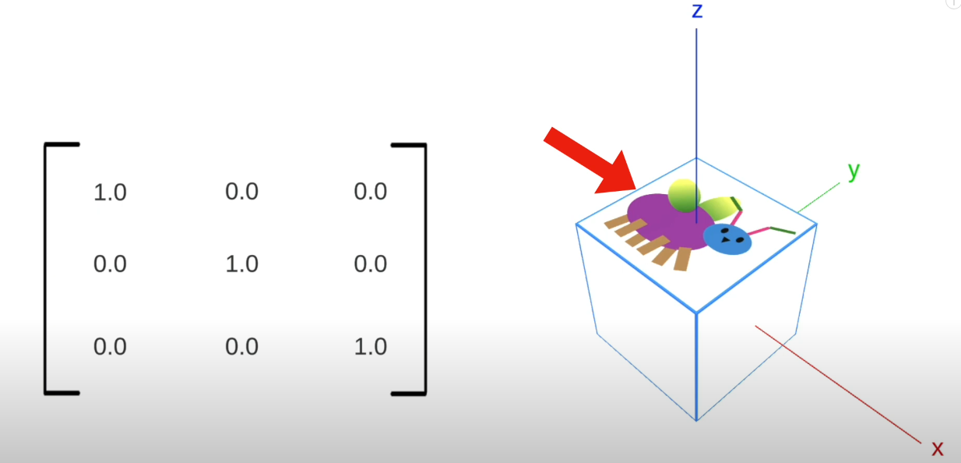
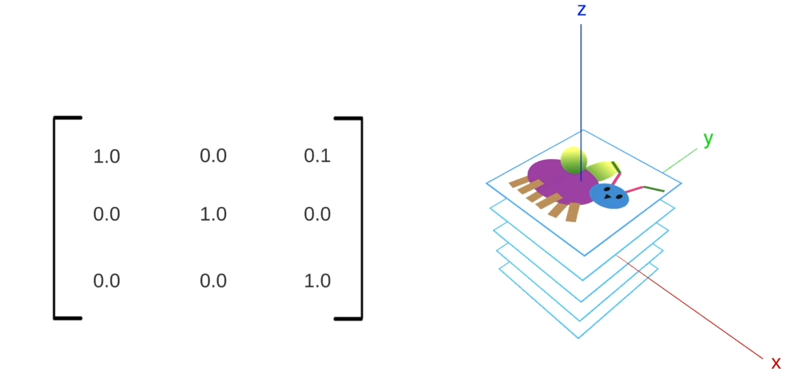
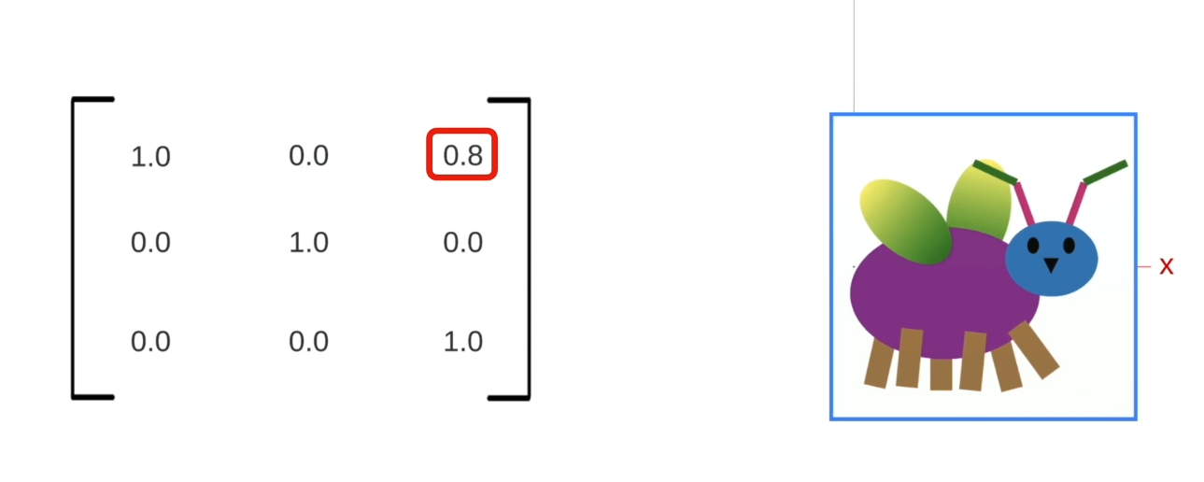

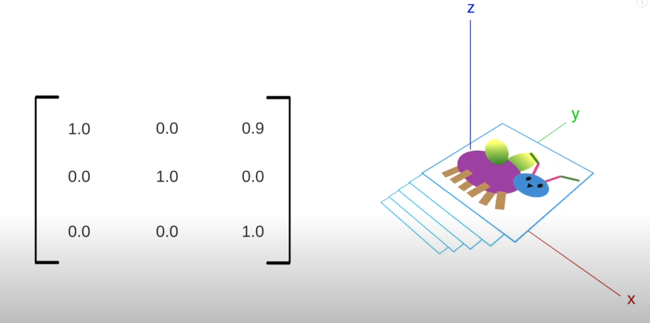


Slide 9
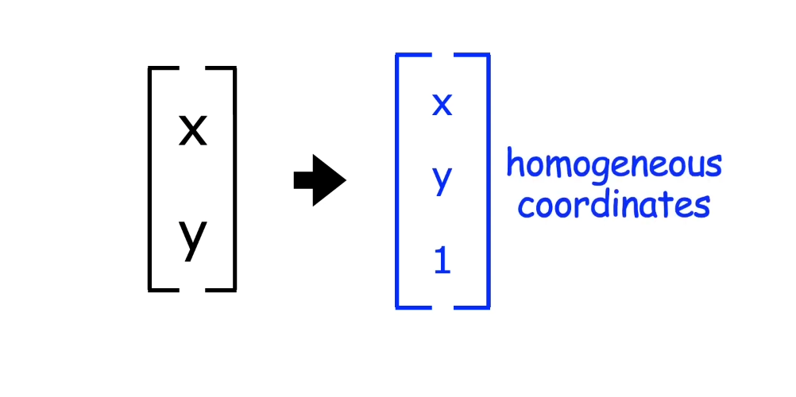

Slide 10
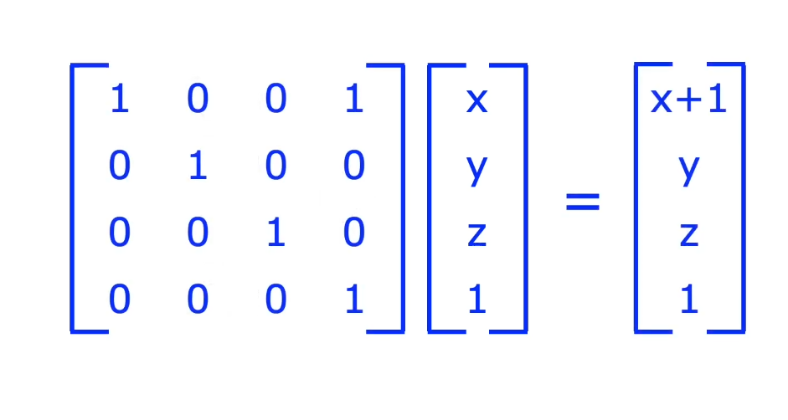
3D translation done by using the 4x4 matrix

Slide 11
// C++ program to demonstrate use of pointers in C++;
#include <iostream>
using namespace std;
int main()
{
int x = 10; // variable declared
int* myptr; // pointer variable
// storing address of x in pointer myptr
myptr = &x;
cout << "Value of x is: ";
cout << x << endl;
// print the address stored in myptr pointer variable
cout << "Address stored in myptr is: ";
cout << myptr << endl;
// printing value of x using pointer myptr
cout << "Value of x using *myptr is: ";
cout << *myptr << endl;
return 0;
}

Slide 12
// C++ Program to demonstrate use of references
#include <iostream>
using namespace std;
int main()
{
int y = 10;
// ref is a reference to x.
int& myref = y;
// changing value of y to 20
y = 30;
cout << "value of y is " << y << endl;
cout << "value of myref after change in value of y is: "
<< myref << '\n';
return 0;
}

Slide 13
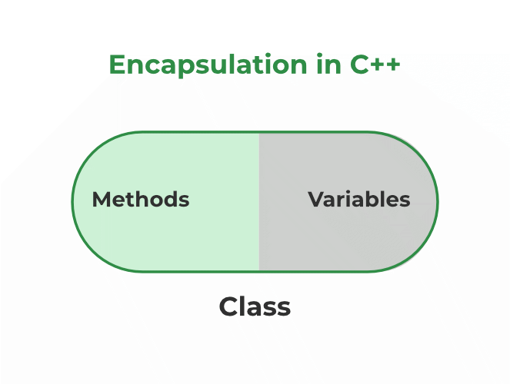
Features of Encapsulation
Below are the features of encapsulation:
We can not access any function from the class directly. We need an object to access that function that is using the member variables of that class.
The function which we are making inside the class must use only member variables, only then it is called encapsulation.
If we don’t make a function inside the class which is using the member variable of the class then we don’t call it encapsulation.
Encapsulation improves readability, maintainability, and security by grouping data and methods together.
It helps to control the modification of our data members.
Encapsulation also leads to data abstraction. Using encapsulation also hides the data, as in the above example, the data of the sections like sales, finance, or accounts are hidden from any other section.

Slide 14
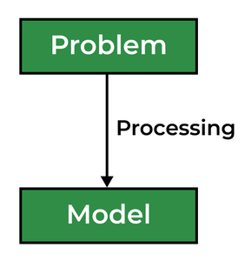
Abstraction in C++
Data abstraction is one of the most essential and important features of object-oriented programming in C++. Abstraction means displaying only essential information and hiding the details. Data abstraction refers to providing only essential information about the data to the outside world, hiding the background details or implementation.
Types of Abstraction:
Data abstraction – This type only shows the required information about the data and hides the unnecessary data.
Control Abstraction – This type only shows the required information about the implementation and hides unnecessary information.
Abstraction using Classes
Abstraction in Header files
Abstraction using Access Specifiers

Slide 15
// C++ Program to Demonstrate the
// working of Abstraction
#include <iostream>
using namespace std;
class implementAbstraction {
private:
int a, b;
public:
// method to set values of
// private members
void set(int x, int y)
{
a = x;
b = y;
}
void display()
{
cout << "a = " << a << endl;
cout << "b = " << b << endl;
}
};
int main()
{
implementAbstraction obj;
obj.set(10, 20);
obj.display();
return 0;
}

Slide 16
Advantages of Data Abstraction
Helps the user to avoid writing the low-level code
Avoids code duplication and increases reusability.
Can change the internal implementation of the class independently without affecting the user.
Helps to increase the security of an application or program as only important details are provided to the user.
It reduces the complexity as well as the redundancy of the code, therefore increasing the readability.

Slide 17
THANK YOU Shubham Agrahari Software Engineer Intern Shubham.agrahari@cyncly.com

